Slide 1

Multi-Relational Stacking Ensemble Recommender System Using Cinematic Experience
(Index Terms)
Graph Neural Network (GNN)
Recommender system
Sentiment analysis
Emotion analysis
BERT
Master Student at KAIST KSE
Presenter : Cheonsol Lee
Notes:
Hello~ Myname is Cheonsol Lee.
I’m a master student at KAIST KSE.
My research subject is “Multi-Relational Stacking Ensemble Recommender System Using Cinematic Experience”.
I will use the concept of Cinematic Experience, which is frequently used in film-related literature. In my research, index terms are GNN, recommender system, sentiment analysis, emotional analysis, and BERT.

Slide 2
1
Introduction
2
Related Work
3
Method
INDEX
4
Experiment
5
Results
6
Conclusion

Slide 3
1. Introduction
Thank you

Slide 4


1. Motivation
Industry of Recommender System
User experience(UX) is required for personalized marketing.
When watching the movies, UX may be expressed as Sentiment/Emotion data.
Cinematic Experience (CX) [1]
It means unforgettable experiences from watching a film.
CX: Physical feature(ex- 4K movie) + Psychological feature(ex- Mood)
User’s psychological information -> Sentiment/Emotion
But the rating only has a limited CX scope, there is a fundamental limitation of recommendation.
Also, the CX field has not been fully researched.
If the sentiment, emotion information is extracted in review, they can be used as meaningful features.
[1] Cinematic experience, film space, and the child’s world (Canadian Journal of Film Studies 2010)
Notes:
In the industry of Recommender system,
The company needs User Experience for personalized marketing.
So, they collects UX information through customer report or reviews.
When watching the movies, UX may be expressed as Sentiment/Emotion data.
In the journal of movie, they use frequently Cinematic Experience word.
It means unforgettable experiences from watching a film.
In the detail, it is divided into physical feature and psychological feature.
In my research, I focused on user’s psychological features such as sentiment and emotion.
But the rating only has a limited CX scope, there is a fundamental limitation of recommendation.
Also, the CX field has not been fully researched.
If the sentiment, emotion information is extracted in review, they can be used as meaningful features.

Slide 5
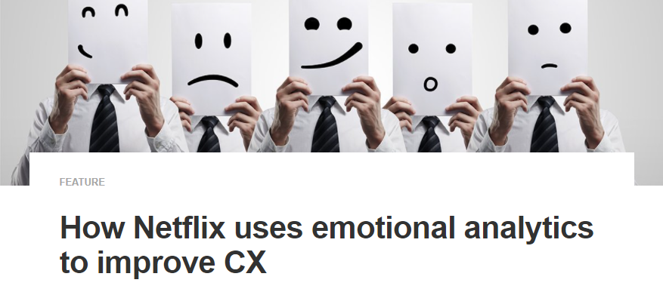

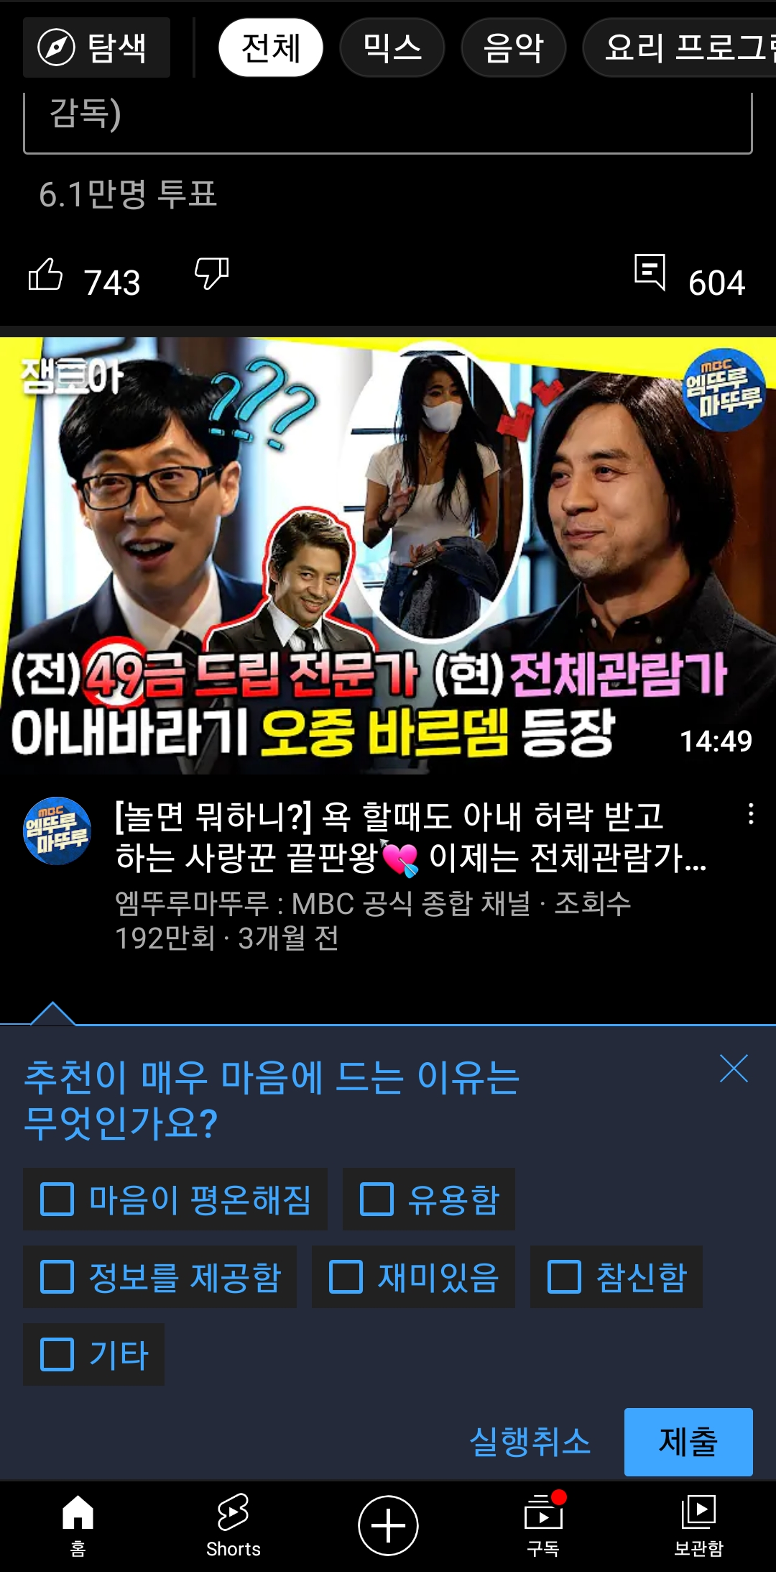
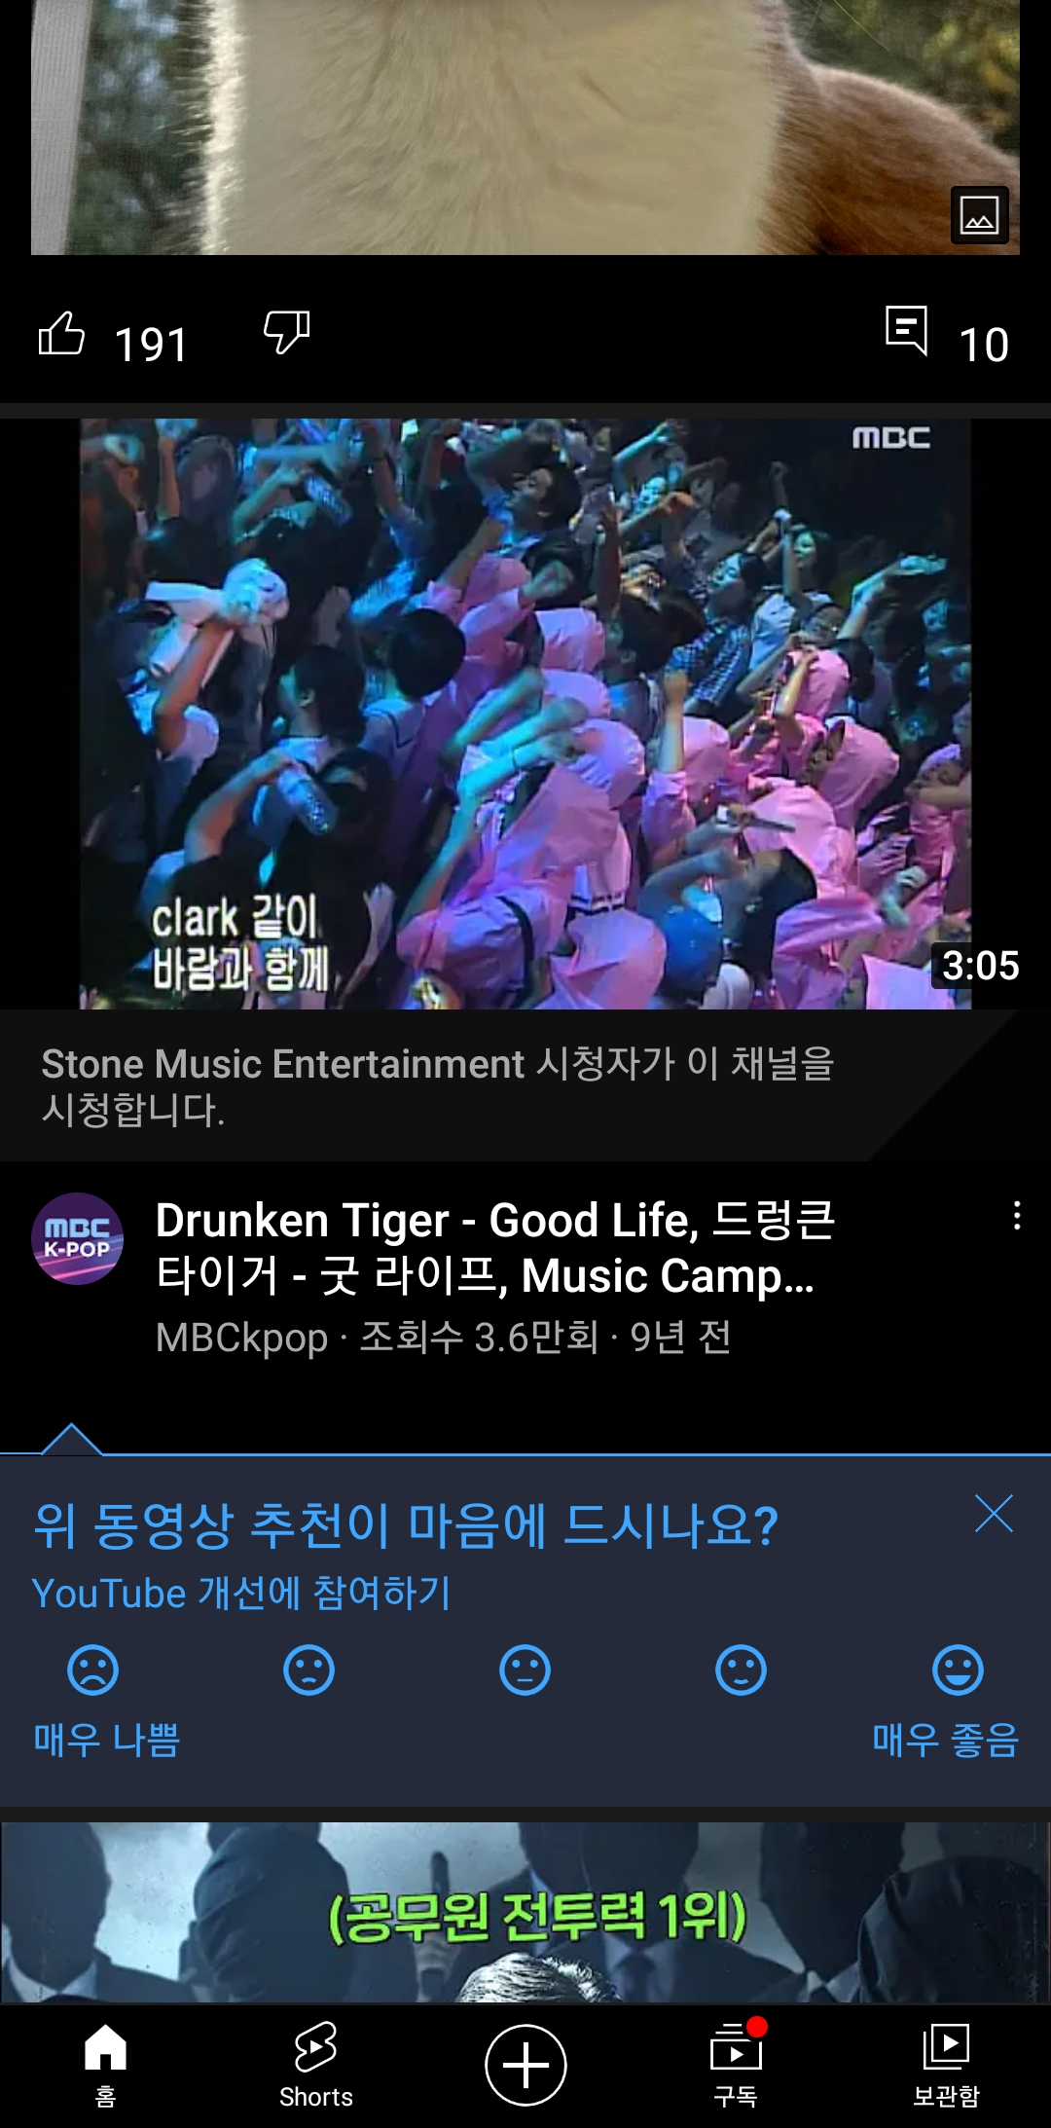

1. Industrial Cases
Industrial Cases of Sentiment/Emotion for Personalized Recommendation
Netflix
Emotional analytics to improve CX
Emotional analytics enable businesses to obtain customer feedback.
YouTube
Report : Sentiment(5-levels), Emotion(part level)
<Technical report>
<Sentiment>
<Emotion>
Notes:
Let me tell you an example / of the industry / that is paying attention to the Cinematic Experience. There are two cases / where companies use sentiment and emotion / for personalized recommendation. First, according to Netflix's technical report, / emotional analysis is used to improve CX. They obtain customer feedback in the review / and conduct emotional analysis.
After that, they apply it to the business. Second, YouTube is asking for continuous feedback / only for premium customers. In this way, / I would like to tell you that / the industry is interested in sentiment and emotion, / and there is a need for our research.

Slide 6
1. Background
Definition
Sentiment divides user’s positive and negative feelings into 5-levels. (Type: ordinal)
Emotion divides user’s psychological feelings into 6-levels. (Type: categorical)
0 | 1 | 2 | 3 | 4
Negative | Somewhat Negative | Neutral | Somewhat Positive | Positive
0 | 1 | 2 | 3 | 4 | 5
anger | fear | joy | love | sadness | surprise
Notes:
In my reseach, I will use sentiment and emotion.
I defined their concepts differently.
Sentiment divides user’s positiveand negative feelings into 5-levels.
The larger the number, the more positive it is. So, it is ordinal type.
Emotion divides user’s psychological feelings into 6-levels.
This represents independent feelings. So, it is categorical type.

Slide 7
1. Research Question (RQ)
RQ1) Is it possible to improve performance by embedding affective Cinematic Experience in model?
RQ2) Which model performs the best rating prediction in algorithms?
Notes:
The Research Question come up with two ideas. First, Is it possible to improve performance by embedding affective Cinematic Experience in model?
Second, Which model performs the best rating prediction in algorithms?
I'll explain it on the next page.

Slide 8
2. Related Work
Thank you

Slide 9
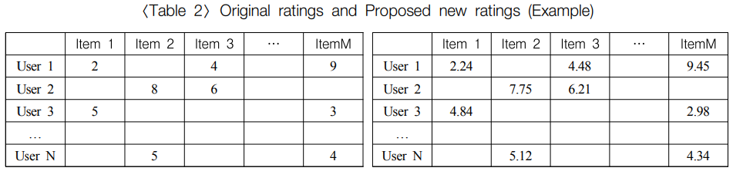
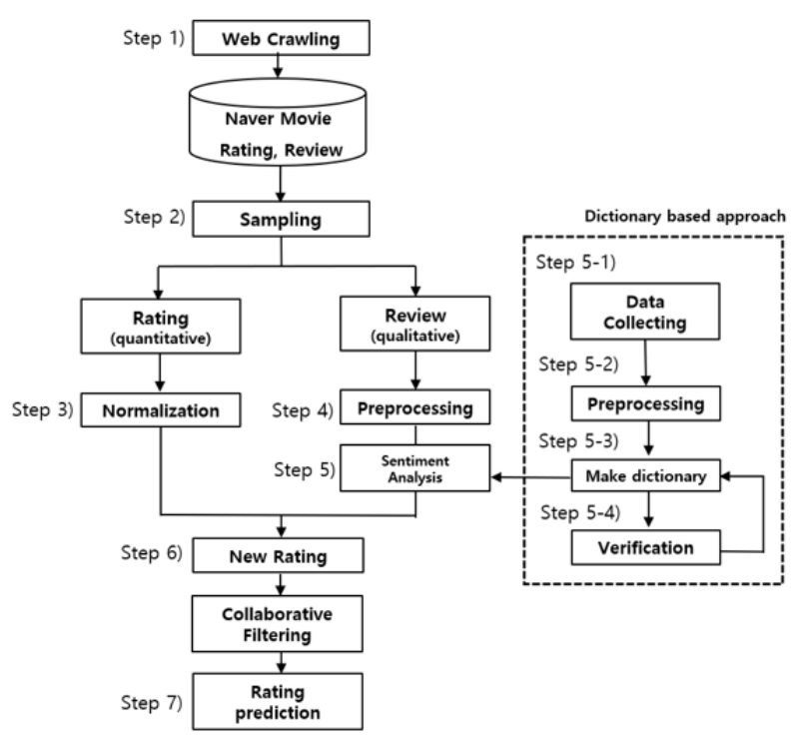
2. Related Work (cont’d)
Sentiment Analysis + RecSys
If the review is quantified, elaborate recommendations are possible.
Various analysis methods that were only possible with structured data are possible.
<Original ratings>
<New ratings>
<Overview of the proposed framework>
Reference: How to improve the accuracy of recommendation systems: Combining ratings and review texts sentiment scores (JIIS 2019)
Notes:
First example is sentiment analysis + recommender system. Review data is analyzed through emotional dictionary and statistical method, After that, combine this with the original rating / to create new ratings.
(그림) It is original ratings. Bottom side is new ratings.
The new ratings enter the recommender system / and predict the missing rating.
This research argues as follows. If the review is quantified, elaborate recommendations are possible.
Various analysis methods that were only possible with structured data are possible.

Slide 10
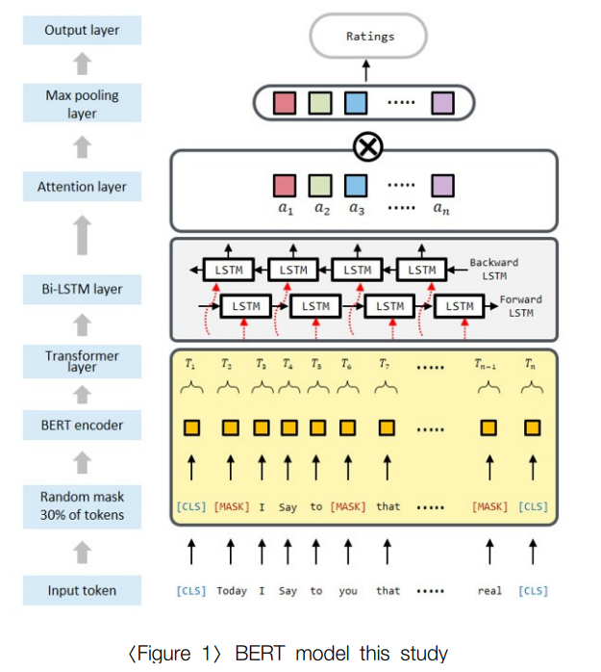
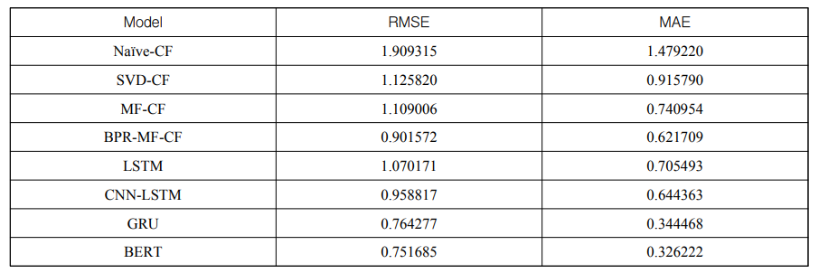
2. Related Work (cont’d)
BERT + RecSys
The BERT-based method is better than traditional methods.
The BERT-based method can proceed with sentiment analysis and recommendation at the same time, simplifying the recommendation process.
Output: rating
BERT
Input: review
< Framework based on BERT >
< Experimental results >
Reference: Recommender System Using BERT Sentiment Analysis (JIIS 2021)
Notes:
Second example is BERT + recommender system.
If you train BERT by using reviews as inputs and ratings as outputs, recommender system can be implemented / only with the BERT model.

Slide 11
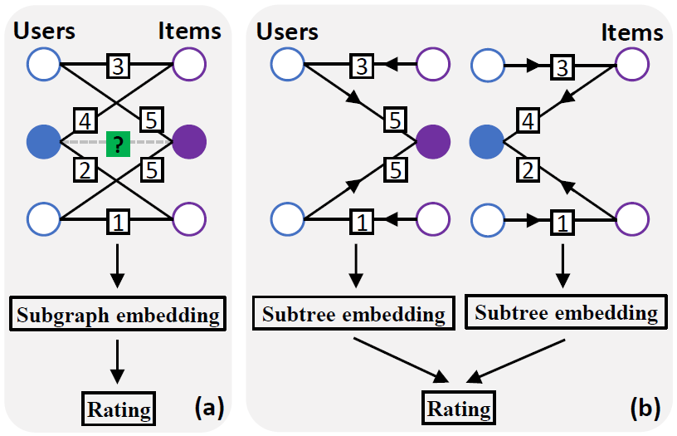
2. Related Work (cont’d)
GNNs for matrix completion
Node-level GNN: It focuses on the user or item embedding.
Graph-level GNN: It focuses on the subgraph embedding.
<Node-level GNN>
ex) GCMC
<Graph-level GNN>
ex) IGMC
Reference: [11] Graph Convolutional Matrix Completion (KDD 2018)
Reference: [12] Inductive Matrix Completion Based on Graph Neural Networks (ICLR 2020)
Notes:
I used the GNN model as the baseline model to further improve the performance of related research.
The GNN model used for matrix completion / is divided into node-level and graph-level methods.
In node-level GNN, it focuses on each user and item to create subtree embeddings
and dot-product them to predict ratings.
Representatively, there is a GCMC model.
In graph-level GNN, it focuses on the subgraph embedding.
Representatively, there is a IGMC model.
In my research, I used GCMC model.
I used the IGMC model in a follow-up study.

Slide 12
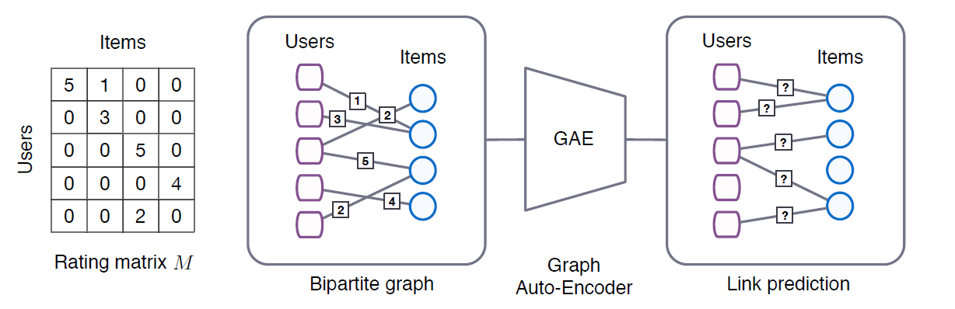
2. Related Work (cont’d) – GCMC
Graph Convolutional Matrix Completion (KDD 2018)
Graph auto-encoder framework predicts the new ratings by transforming the rating matrix in a bipartite graph.
Better performance than conventional recommendation models.
Graph model : GCN
Characteristics
Node-level embedding
Side-information needed : user(age, gender, and occupation), item(genre, title, and year of the movie)
Reference: [11] Graph Convolutional Matrix Completion (KDD 2018)
Notes:
Graph Convolutional Matrix Completion is released in KDD 2018. / They call it GCMC for short.
The GCMC model transforms / the user-item's rating matrix / into a bipartite graph and uses a graph autoencoder to predict missing ratings.

Slide 13
3. Method
Thank you

Slide 14
3. Method
Web Crawling
Movie Database
Sampling
Review
Rating
Review
BERT
BERT
Normalization
Sentiment / Emotion
Sentiment
Emotion
Multi-relations graph
generating
Graph Model
Rating Prediction
Figure 1. Overview of the proposed framework
Notes:
The proposed framework is as follows. Movie dataset are crawled from the movie review site called Rotten tomatoes. Sentiment and emotion are extracted through the BERT models.
The BERT models were trained with training set / for sentiment and emotion analysis in advance. Rating, sentiment, and emotion are combined into a multi-relational graph. Using this multi-relational graph, we can predict missing rating.

Slide 15
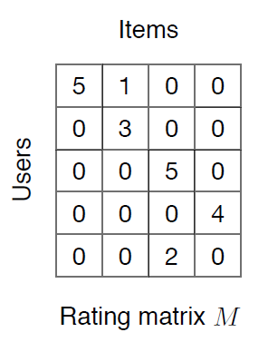
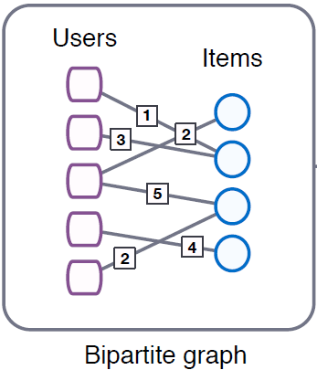
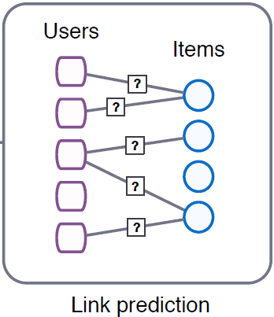
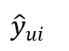
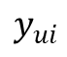
3. Framework – Baseline
User features: top_critic, publisher_name
Item features: title, year, genres
Target
$$y_{ui}$$
User embedding
GCMC
Encoder
GCMC
Decoder
$${\hat{y}}_{ui}$$
Prediction
Item embedding
Reference: [11] Graph Convolutional Matrix Completion (KDD 2018)
Notes:
GCMC is used as the baseline model, / which obtains user and item embedding.

Slide 16
3. Framework – Baseline + IDEA concept
Target
$$y_{ui}$$
M | R | U
0 | 3 | 1
1 | 2 | 1
2 | 1 | 2
User embedding
GCMC
Encoder
GCMC
Decoder
$${\hat{y}}_{ui}$$
Prediction
Item embedding
(Rating)
Notes:
Before GCMC Encoder, I added the IDEA.

Slide 17
3. Proposed Framework
M | R | U
0 | 3.5 | 1
1 | 4.7 | 1
2 | 1.3 | 2
Target
$$y_{ui}$$
(Rating)
M | R | U
0 | 3 | 1
1 | 2 | 1
2 | 1 | 2
User embedding
GCMC
Encoder
GCMC
Decoder
$${\hat{y}}_{ui}$$
Prediction
Item embedding
(Sentiment)
M | R | U
0 | 5 | 1
1 | 2 | 1
2 | 3 | 2
(Emotion)
Notes:
I made already multi-relational graph.
And input this graph into GCMC Encoder.
User and item embeddings are the result / of including three types information.

Slide 18
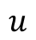
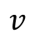
3. Proposed Framework
rating
2
3
3
sentiment
emotion
3
rating
12
sentiment
item
emotion
 |  | 0
 |  | 1
 |  | 0
17
user
Figure 2: multi-relational graph
rating 2
rating 3
rating 4
Figure 3: Graphs and adjacent matrices
for user 2 and movie 3 about rating edge
Notes:
This is multi-relational graph.
It has three edge types such as rating, sentiment and emotion.
In the GCMC Encoder, / adjacency matrices are generated according to the rating, sentiment, and emotion score.
This is example / when rating score 3 is represented into adjacency matix.

Slide 19
4. Experiment
Thank you

Slide 20
4. Experiment – dataset (Movie)
Dataset
Period : 1914.06.01 ~ 2020.10.31
Link : https://www.kaggle.com/stefanoleone992/rotten-tomatoes-movies-and-critic-reviews-dataset
Data
File name | Dimension | Columns
Movie data | (17713, 22) | 'rotten_tomatoes_link', 'movie_title', 'movie_info', 'critics_consensus', 'content_rating', 'genres', 'directors', 'authors', 'actors', 'original_release_date', 'streaming_release_date', 'runtime', 'production_company', 'tomatometer_status', 'tomatometer_rating', 'tomatometer_count', 'audience_status', 'audience_rating', 'audience_count', 'tomatometer_top_critics_count', 'tomatometer_fresh_critics_count', 'tomatometer_rotten_critics_count'
Review data | (1048576, 8) | rotten_tomatoes_link, critic_name, top_critic, publisher_name, review_type, review_score, review_date, review_content
Rating | Review | Amount | Rate
O | O | 758,709 | 67%
X | O | 305,502 | 27%
O | X | 65,372 | 5%
X | X | 434 | 0.03%
Notes:
We used a crawled dataset from a movie review site called rotten tomatoes.
Here, we experimented with data / had both ratings and reviews.

Slide 21
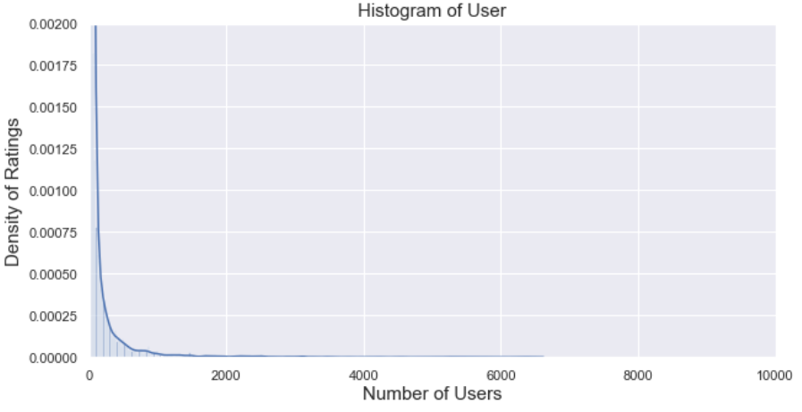
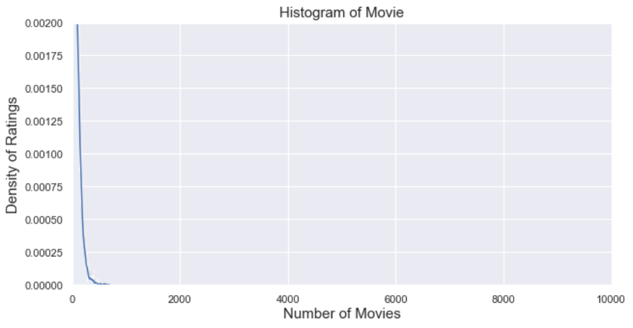
4. Experiment – dataset (movie)
Long-tail graphs
Group: User, Movie
Train/test rate = 9 : 1 (by timestamp)
Number: user_id(850), movie_id(6,805)
Exclude cold-start problem (user, item)
Range | User | Movie
Total | 9,794 | 17,614
< 3 | 3,552 (36%) | 993 (6%)
< 5 | 4,653 (48%) | 2,892 (16%)
>= 20 | 2,994 (31%) | 8,110 (46%)
>= 500 | 345 (4%) | 13 (0%)
Reviews >= 20
<User>
<Movie>
Notes:
Simillary general recommender system data, the data graphs are long-tail shape. We used data left more than 20 reviews. In order to exclude the cold-start problem, / the train/test data was configured at a ratio of 9 to 1 according to timestamp.

Slide 22
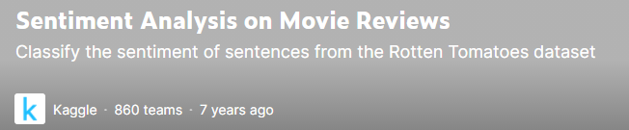
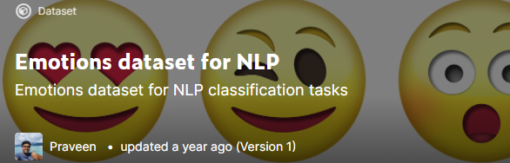
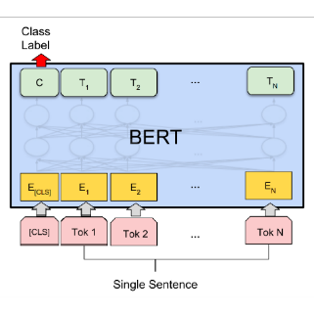
4. Experiment – dataset (sentiment, emotion)
Sentiment, Emotion dataset
Training data for BERT model in Kaggle
Sentiment[1]
Emotion[2]
Feature generating/augmentation using BERT fine-tuning
0 | 1 | 2 | 3 | 4
Negative | Somewhat Negative | Neutral | Somewhat Positive | Positive
0 | 1 | 2 | 3 | 4 | 5
anger | fear | joy | love | sadness | surprise
Review data
Result
U | E | M
0 | 1 | 1
1 | 3 | 1
2 | 2 | 2
Uma Thurman as Medusa, the gorgon with a coiffure of writhing snakes and stone-inducing hypnotic gaze is one of the highlights of this bewitching fantasy
Sentiment, emotion value
(graph)
[1] Sentiment Analysis on Movie Reviews
[2] Emotion dataset for NLP
Notes:
To get sentiment and emotion data from the review, We trained independent BERT models using training sets / for sentiment and emotion analysis in Kaggle. By entering Rotten tomato's review data into BERT models, sentiment and emotion data were obtained
After that, we used them as edge information on the graph.

Slide 23
4. Experiment – Grid search
Grid search
Conventional models
Models : KNNWithMeans, SVD, and SVDpp (Surprise library)
Hyperparameter
KNNWithMeans : k(10,15, 25), name(Pearson_baseline, Cosine)
SVD, SVDpp : learning_rate(0.005, 0.006, 0.007)
GCMC based modes
Hyperparameter
Dimensions : 75, 150, 225
Drop out : 0.3, 0.5, 0.7
Learning rate : 0.005, 0.01, 0.02, 0.03
Notes:
Using grid search, we tried to analyze the results / with the best performances.
As a traditional model, collaborative filtering, SVD, and SVD++ were used. As a GNN model, GCMC was used.

Slide 24
5. Results
Thank you

Slide 25
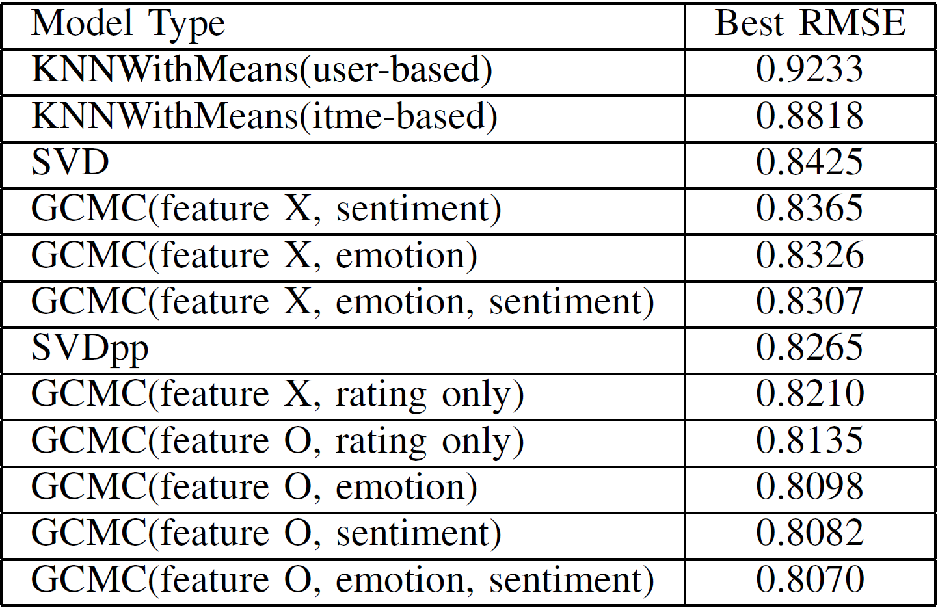
5. Results – Table
GNN-based methods are better than traditional methods.
When CX information is combined with a rating, it is possible to improve the performance of the recommender system.
Table 1: RMSE results
Notes:
The result table is as follows. GNN-based methods are better than traditional methods.
When CX information is combined with a rating, / it is possible to improve the performance of the recommender system.

Slide 26
6. Conclusion
Thank you

Slide 27
6. Conclusion
Natural language information can be used in a graph-based recommender system through a method of stacking BERT.
The Cinematic Experience(CX) information can be a significant feature.
Because the graph reflects the multi-relational information between users and items, CX information can be expected to improve performance in a graph-based method.
Multi-relational graphs can be reflected in the manner we propose, and multi-relations can be replaced by other meta-information between users and items.
Notes:
Natural language information can be used in a graph-based recommender system through a method of stacking BERT.
The Cinematic Experience(CX) information can be a significant feature.
Because the graph reflects the multi-relational information between users and items, CX information can be expected to improve performance in a graph-based method.
Multi-relational graphs can be reflected in the manner we propose, and multi-relations can be replaced by other meta-information between users and items.

Slide 28
Thank you
Thank you
Notes:
Thank you for listening.

Slide 29
Appendix
Thank you

Slide 30
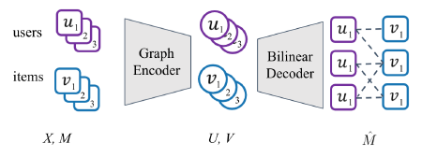
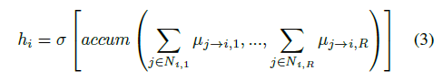
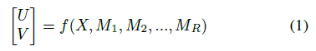
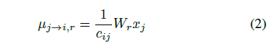
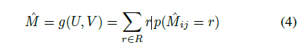
GCMC Algorithm
[GCMC Framework]
[Input data – Matrices, Node features]
[GCN – Message Passing1]
[GCN – Message Passing2]
[Output data – Predicted Matrices]
Notes:
GNN 알고리즘 상세 설명

Slide 31
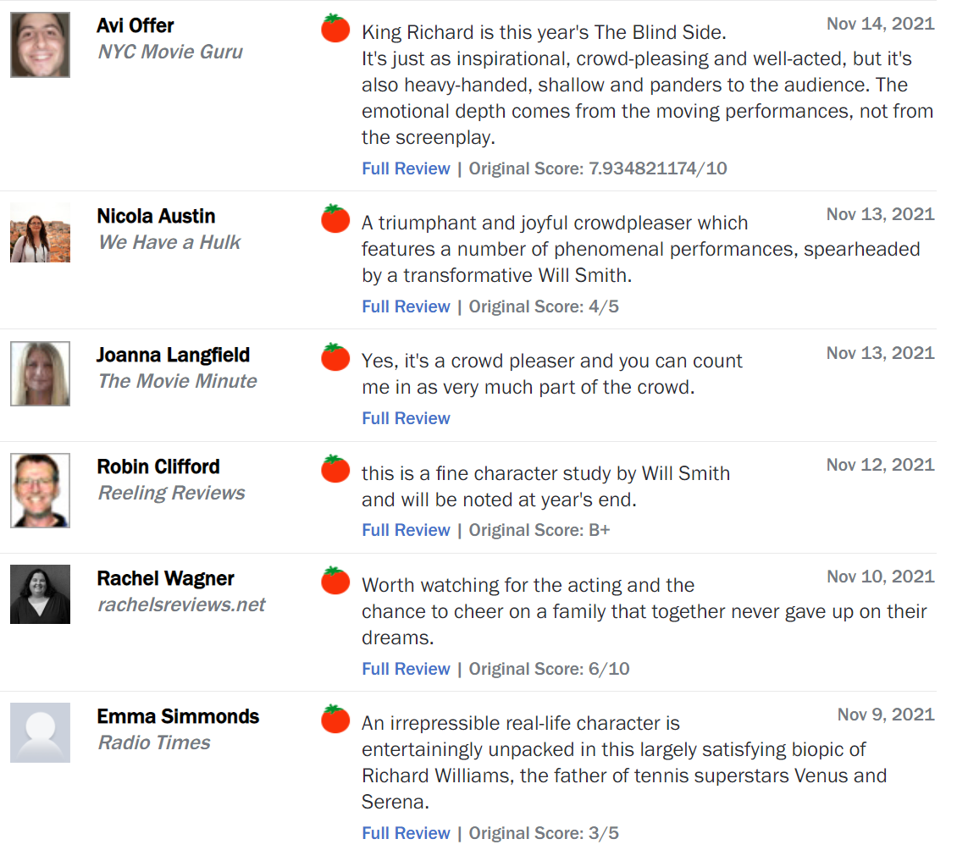
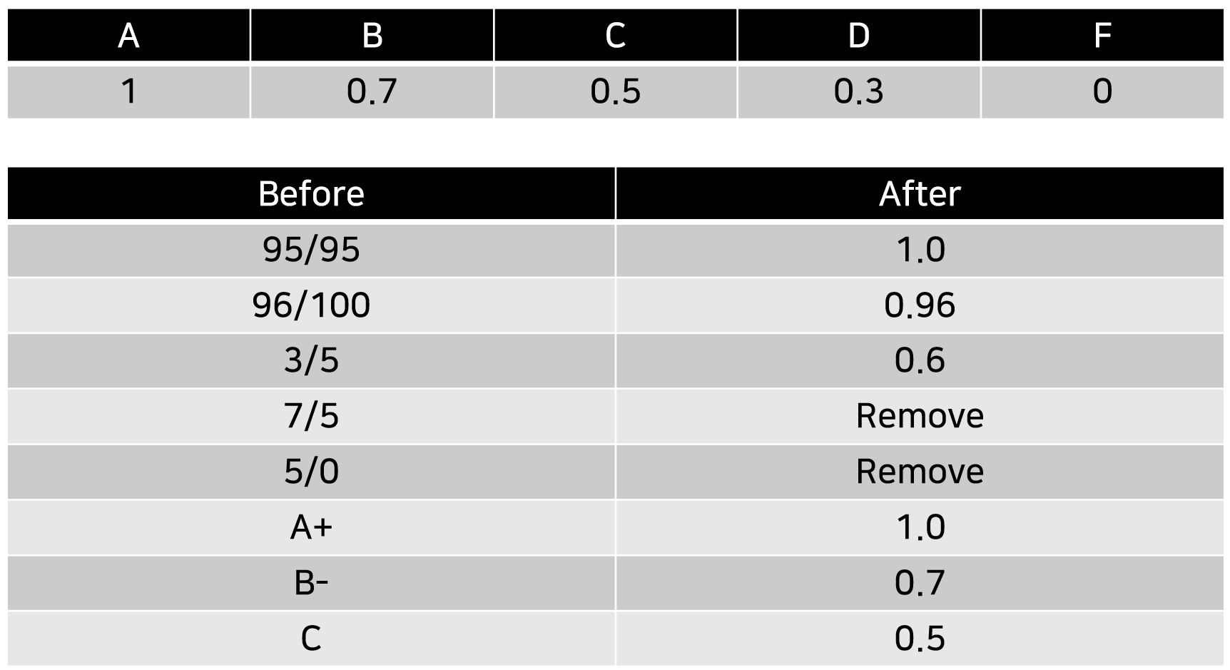
4. Why do you use Rotten Tomato data?
Features of rating score
Unlimited rating system
The need for data refinement
Data close to problems in the field
(Preprocessing)
Notes:
Rotten Tomato 데이터셋으로 선정한 이유는 다음과 같습니다.
일반적으로 추천시스템에서 사용하는 movielens와 같은 벤치마크 데이터셋은 평점 스케일이 1점 단위로 구성됩니다.
하지만, rotten tomato 데이터는 이렇게 독특한 평점 시스템 방식을 도입하고 있습니다.
7.9348, 4/5, B+, 6/10 등 처럼 각자 본인 만의 기준에 따라 자유롭게 평점을 남길 수 있습니다.
이렇게 스케일이 다른 평점데이터들이 정제가 필요할 뿐만 아니라, 실무의 데이터와 가장 유사하다고 판단했고,
본 연구의 모델이 해당 데이터에도 적용할 수 있음을 보이려 했습니다.
전처리는 다음과 같은 기준으로 진행했습니다.

Slide 32
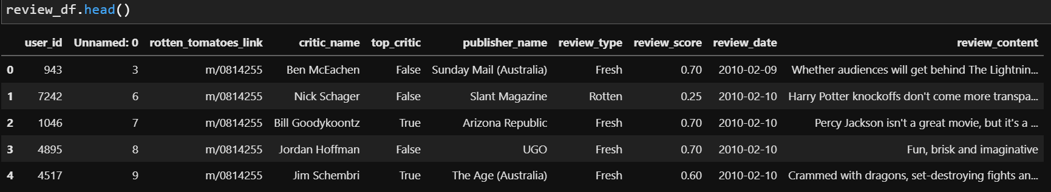
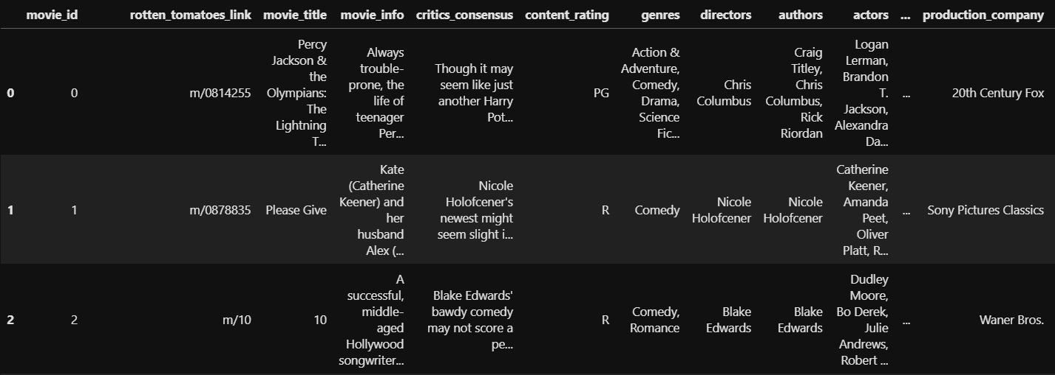
4. Experiment – dataset (Movie)
Dataset
Rating matrix
Group : critic_name, top_critic, publisher_name
The number of users : 9,794
Movie matrix
The number of movies: 17,614
Notes:
사용자 그룹은 다음과 같은 기준으로 ID를 부여했고,
총 9,794명의 사용자를 사용했습니다.
아이템 정보는 17,614건의 데이터를 사용했습니다.

Slide 33
3. Proposed Framework
3
rating
rating (0-9)
1
12
1
sentiment
sentiment (10 - 14)
emotion
17
emotion (15 - 20)
2
0 | 1 | 1 | 0 | 1
0 | 0 | 0 | 1 | 0
1 | 0 | 0 | 1 | 0
1 | 1 | 1 | 0 | 1
1 | 0 | 0 | 1 | 0
2
18
3
1
3
4
4
11
Figure 5: Transforming multi-relational graphs to adjacent matrices

Slide 34
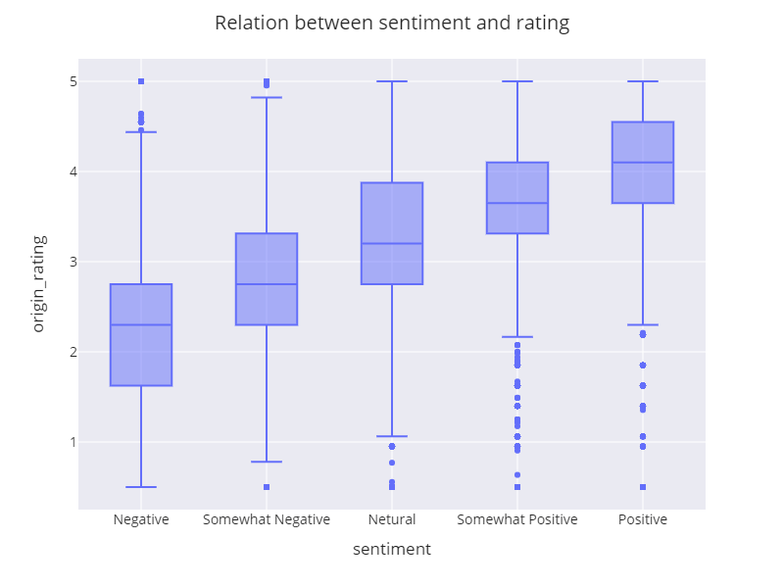
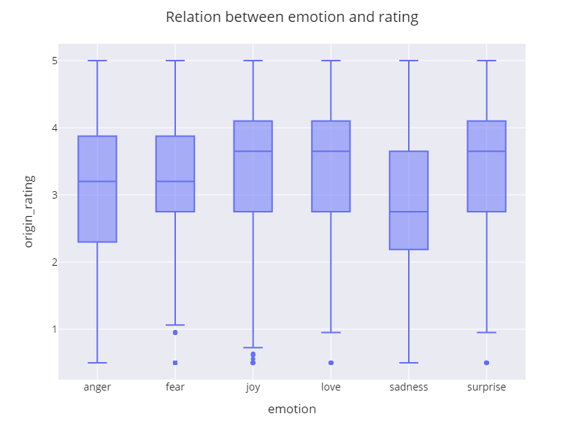
4. Experiment – dataset (sentiment, emotion)
Relation between rating and sentiment/emotion
Figure 7: Relation between sentiment and rating
Figure 8: Relation between emotion and rating

